Slide 1

ACP Project
Schulich Consulting Team 7
Dataraction
x

Slide 2
01
Table of Contents
02
03
04
Introduction
Business Objectives
Data Collection & Architecture
Modelling, Testing, Pipelining, and Improvement
05
Product Demos
06
Conclusion & Future Insights
Challenges & Next Steps
07

Slide 3
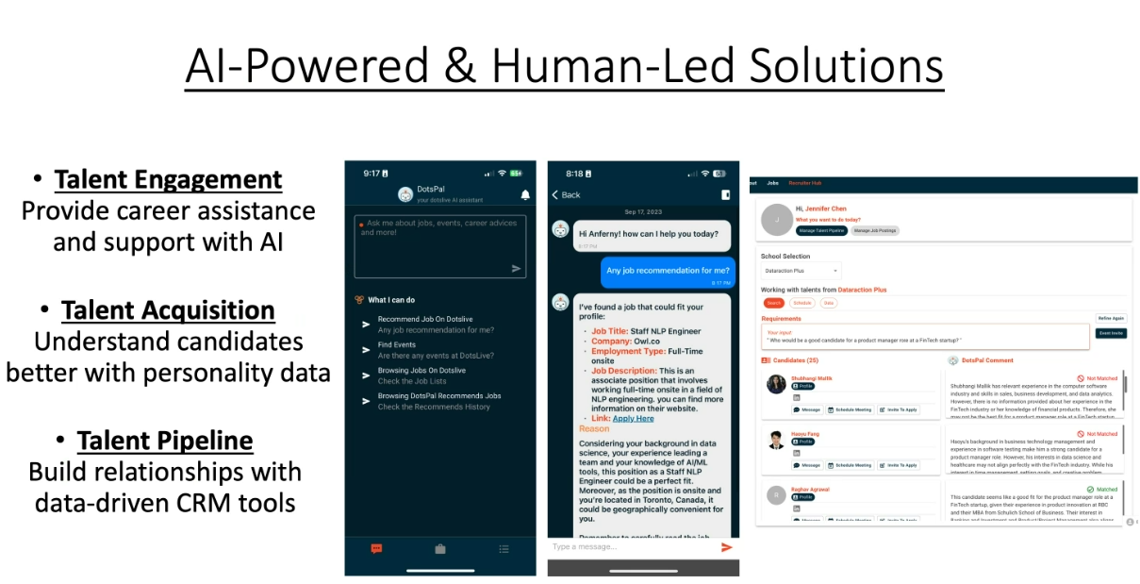
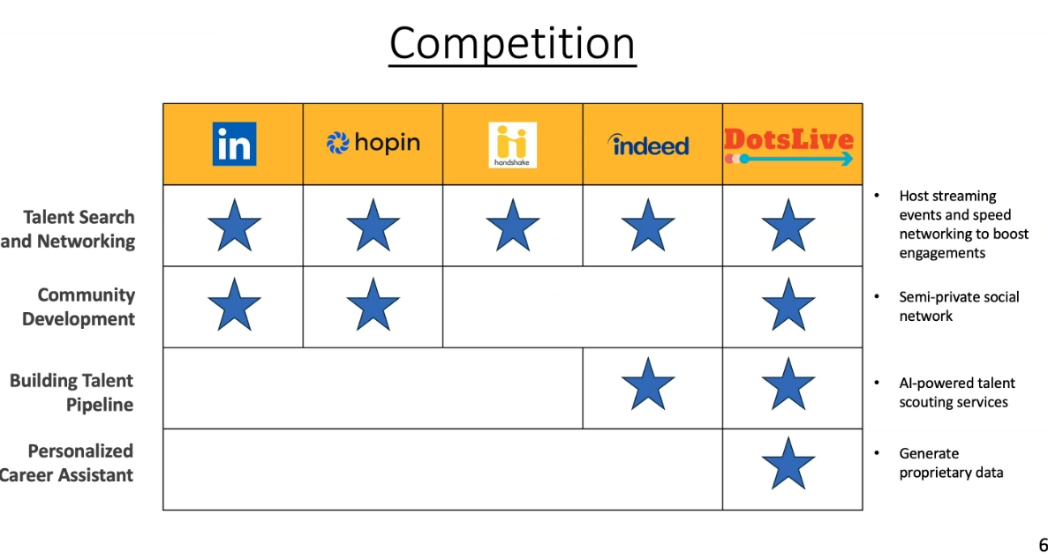
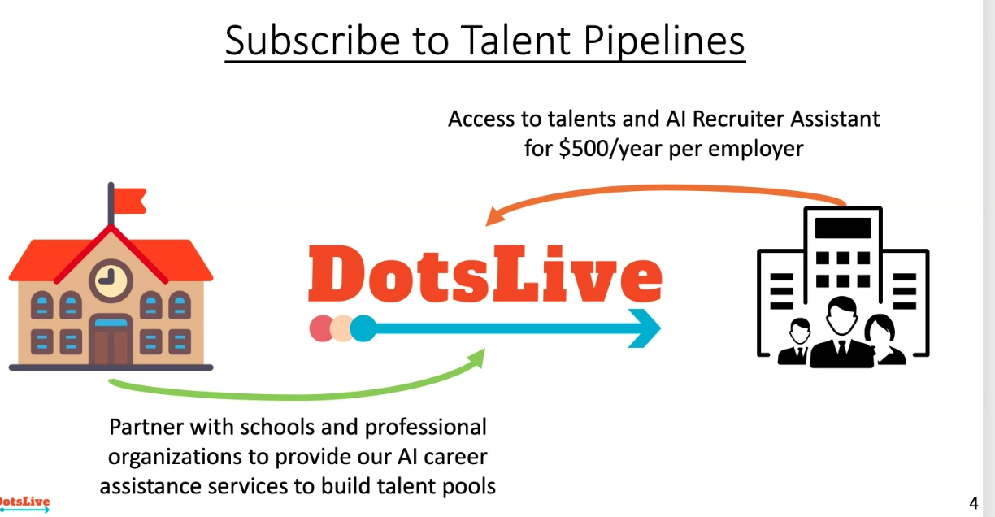
Introduction- The Client

Slide 4


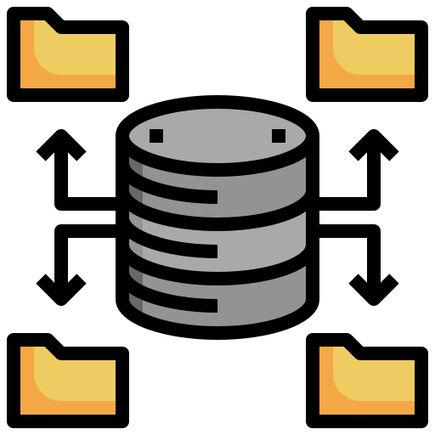



Introduction- Our Project
Original Project
Team 7 Revised Project
Web Scraping
Web Scraping
Data Cleaning
Data Cleaning
Dataset Preparation
Dataset Preparation
Chatbot Career Assistant
Job Seeker Recommender
Hiring Manager Recommender

Slide 5
Business Objectives

Slide 6
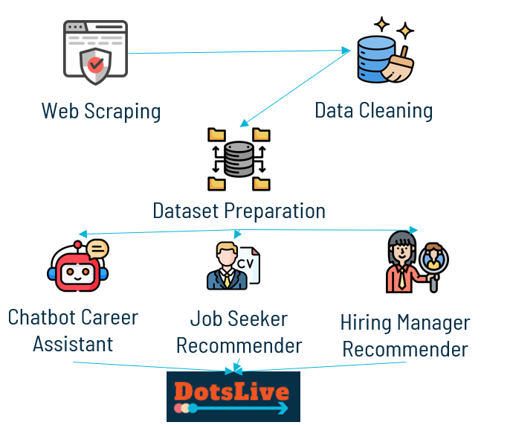
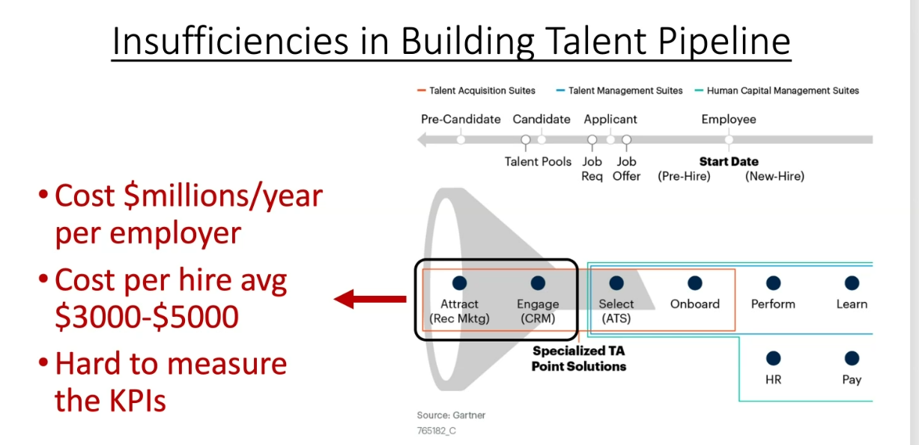
Business Objectives- Dataraction’s Business Model
Objective A: Providing Job Description Information to Dotspal
Objective B (Implementing Recommender System):

Slide 7
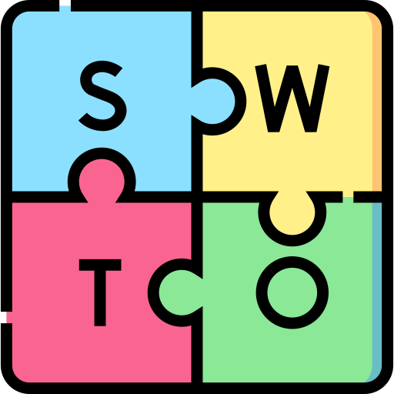
Business Objectives- Dataraction’s Business Model
Objective A: Providing Job Description Information to Dotspal
Strength: Dataraction's Personal Relationships
Strength: Dotspal - Generative AI Tool
Weakness: Reliance on Personal Relationships for Talent Pool
Objective B (Implementing Recommender System):
Strength: Subscription Model for Employers
Strength: Dotspal - Generative AI Tool
Opportunity: Revolutionizing Talent Tracking
Opportunity: Empowering Job Seekers with AI
Threat: Lowering Barrier of Entry and Market Perception
Threat: Cyclical Needs for SMEs

Slide 8
Data Collection & Architecture

Slide 9


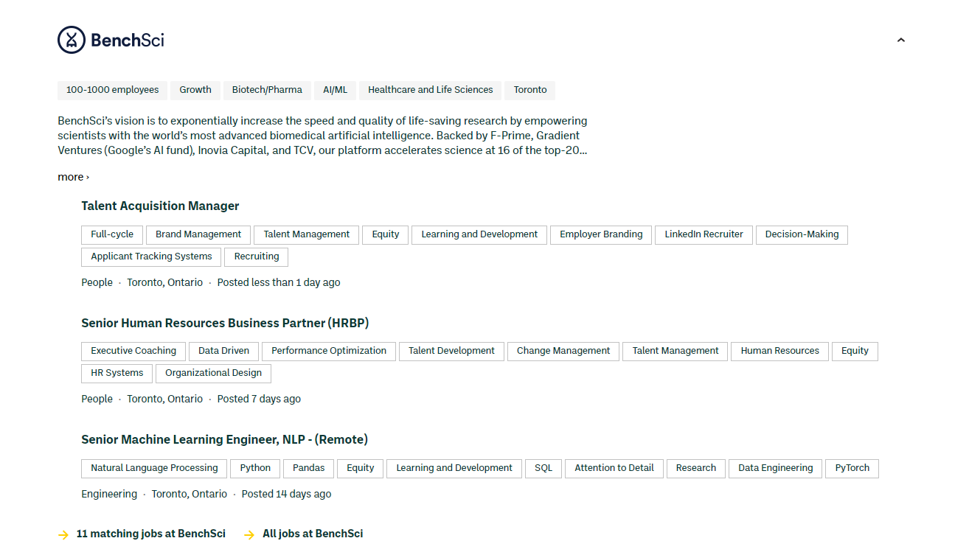
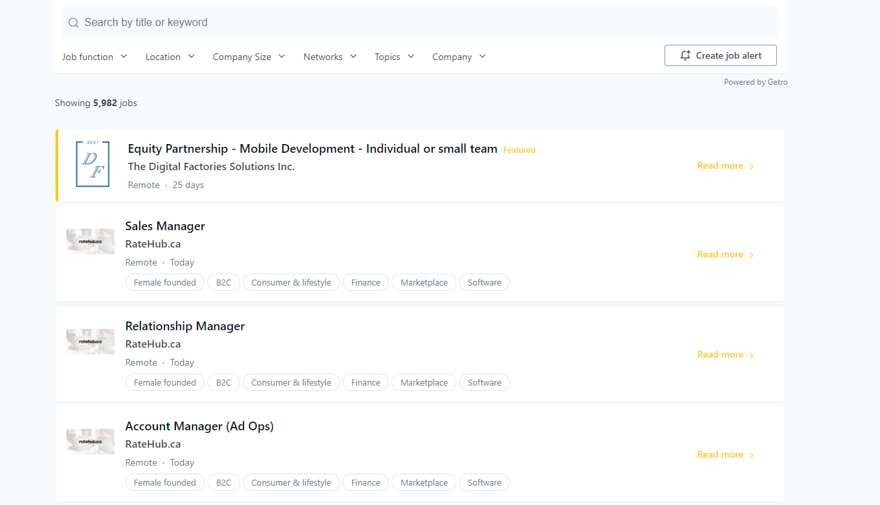
The Data Sources
Golden Ventures Website
Communitech Website

Slide 10
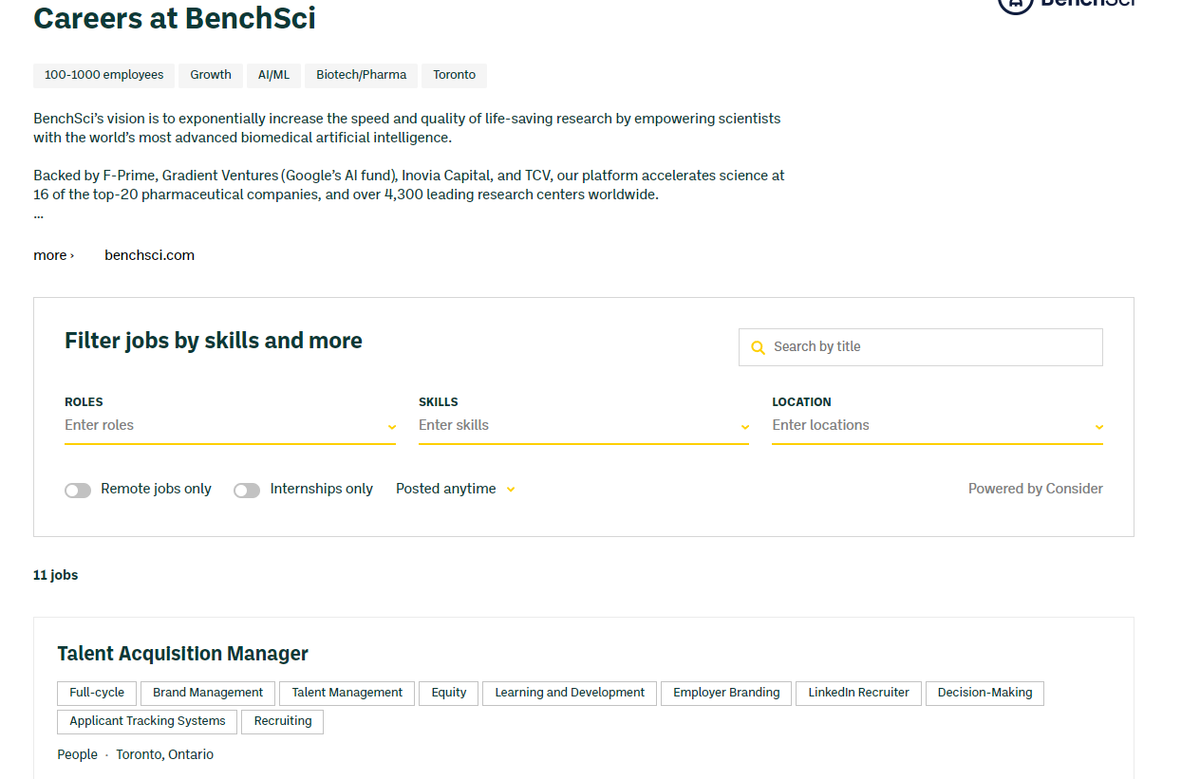
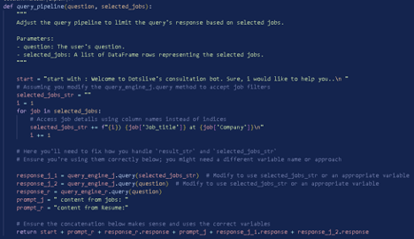
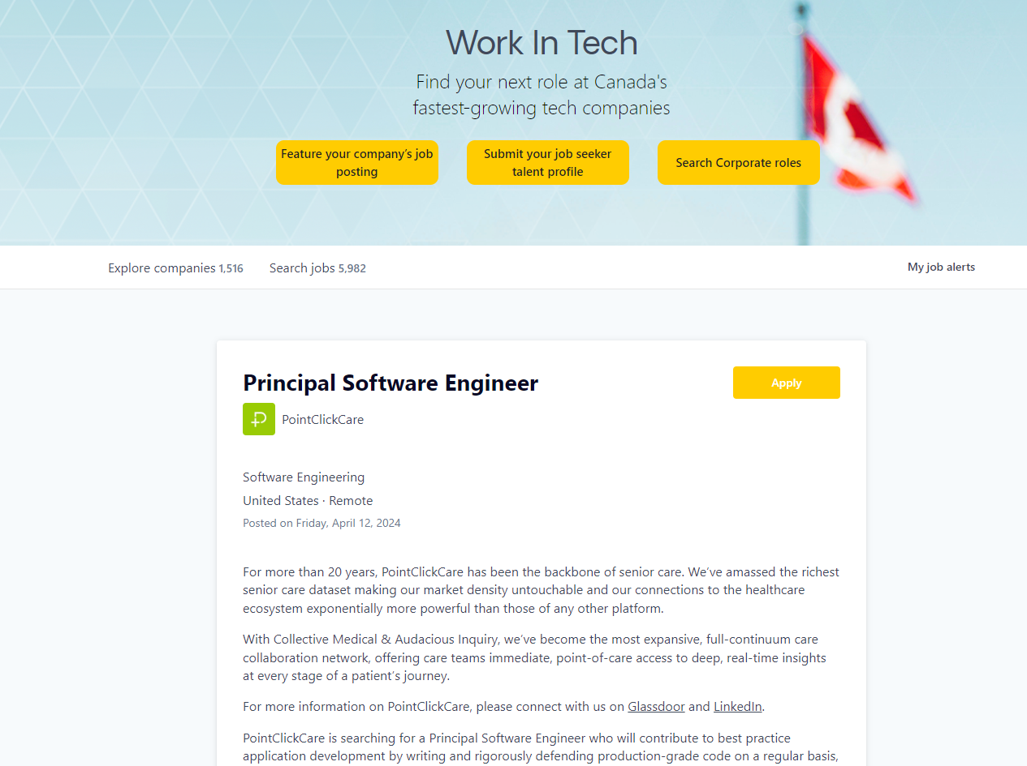
Web Scraping
Web Scraping Code

Slide 11
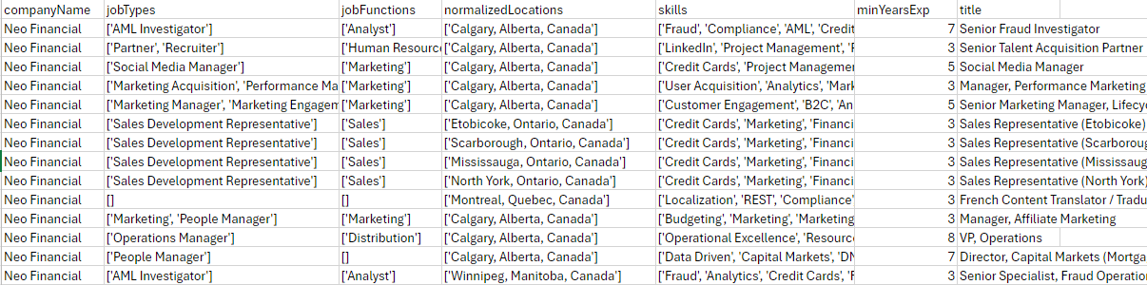
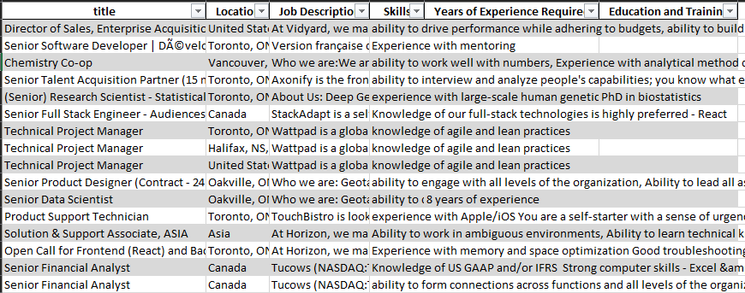
Web Scraping

Slide 12


Final Data Preparation
Data was unusable
Data was useusable
No job description on the website
Thorough job description on the website
No consistency in industry tags and years of experience
Most if not all the jobs had data
This section helped Dataraction achieve objective A as we were able to source a dataset of over 3500+ pieces of tech-related jobs for them

Slide 13
Modelling, Testing, Pipeling, and Improvement

Slide 14

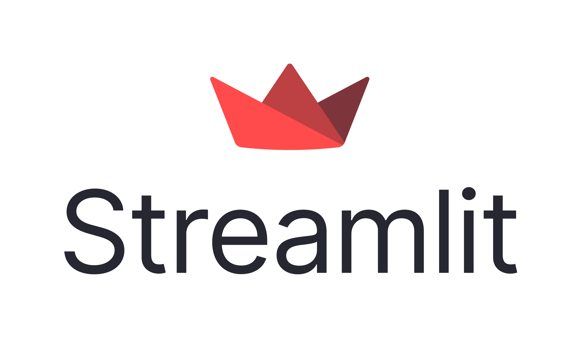


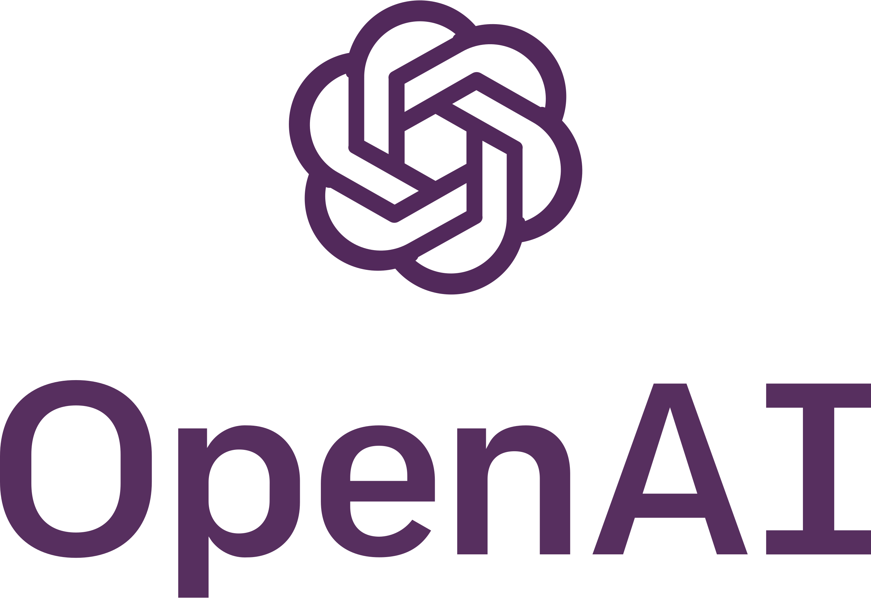



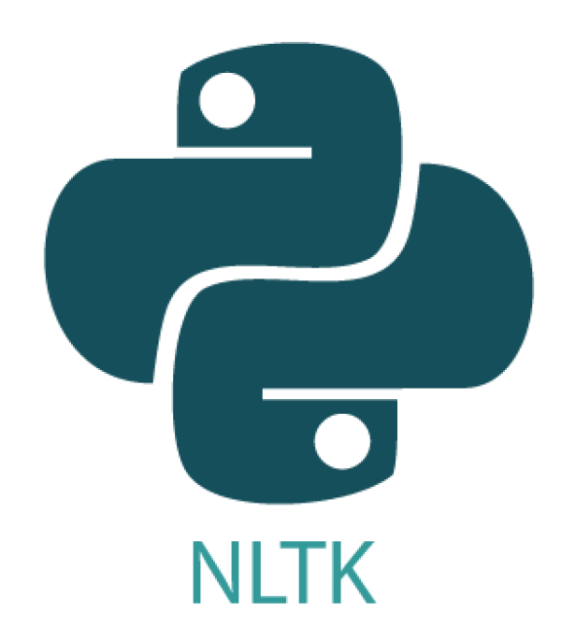

Recommendation Engine
Providing Job Seekers and Hiring Managers with a Similarity Score offering direct insight into the process of seeking and hiring
What technologies did we used to create them
Years of Experience Required
Past Work Experience
Front-End
Education
Skills
Back-End
Location
Projects

Slide 15

Development Roadblocks
Issues During Development
How we overcame these issues
The Years of Experience total on your resume did not necessarily entail that you had the required years of experience for that job
We removed the years of experience from the model
Cosine Similarities by individually extracting the data did not yield high matches based on the test data
We grouped all the extracted sections into one big text group to match the entire past job history
Initial Test against real job seeker data did not yield a accurate match percentage
We realized Communitech was focused on mainly tech jobs so we revised our dataset to include tech jobs only

Slide 16

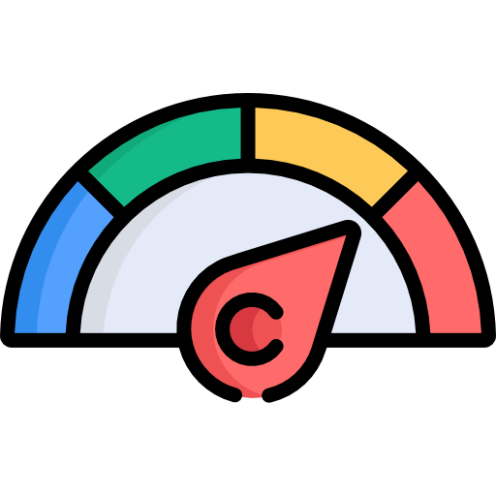
Recommendation Engine Final Product
Past Work Experience
Skills
Similarity Score
Recommendation Engine
Location
Projects
Job Seeker UI
Hiring Manager UI
This helps achieve business objective B as Dataraction can empower job seekers and Hiring manager talent tracking through an AI based score that provides complex information about job matching in an easy manner

Slide 17
Overall Results
Compared to a Hiring Manager the recommendation system was 82% percent accurate
We created three products
Chatbot Career Advisor to simulate dotspal ai career assistant
Job Seeker UI to simulate looking for a career on dataraction website
Hiring Manager UI to simulate talent acquisition and pipeline aspects of the business

Slide 18
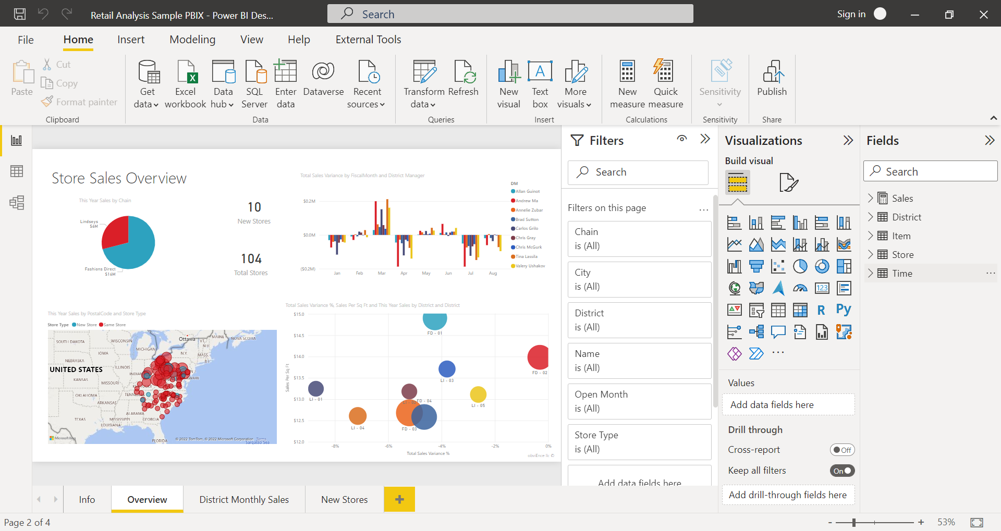
Phase 3 Removal
Phase 3 did not help achieve business objectives as our resume data was generated we had no insight into how representative of the talent pool Dataraction was building therefore, visualizing the matches vs job was not useful

Slide 19
Product Demos

Slide 20
Job Seeker UI

Slide 21
SEE IN GITHUB README

Slide 22
Chatbot Career Advisor

Slide 23
SEE IN GITHUB README

Slide 24
Hiring Manager UI

Slide 25
SEE IN GITHUB README

Slide 26
Conclusion- Business Objectives
Not only achieved them but we overachieved them
Objective A: Providing Job Description Information to Dotspal
Chatbot Career Advisor to simulate dotspal ai career assistant
Job Seeker UI to simulate looking for a career on dataraction website
Hiring Manager UI to simulate talent acquisition and pipeline
Objective B (Implementing Recommender System):

Slide 27
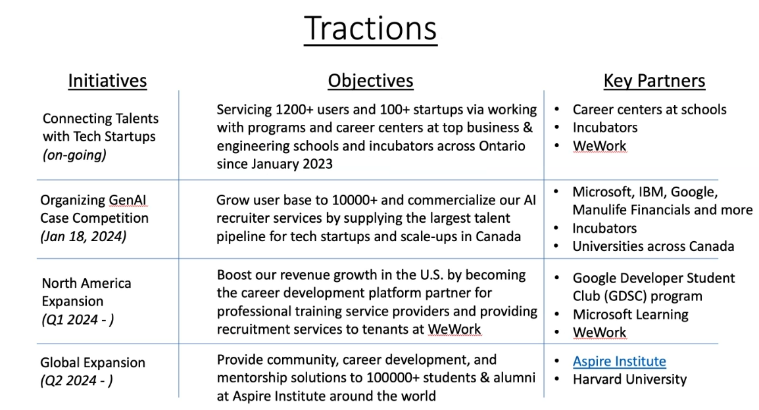
Future Directions
Key Considerations when implementing products final versions
Unstructured Data and Pipeline Necessity
Costing
User Bias
User Interface Deployment
Outliers
Improving the model through more complex features Ex. Years

Slide 28
Challenges
Team Interactions
Client Interactions
Coding Challenges
Working together in an effective manner
Understanding and staying on the same page
Learning to make sacrifices on features

Slide 29
Lessons Learned
Sadia Charoo
If work is started before the end product is finalized and misunderstandings arise ensure to halt work to clarify these misunderstandings.
Supragya Bajpai
Ensure a consistent review of phases through communication to ensure that if items are deemed unnecessary that work is redistributed amongst the team.
Annuj Kamalesan
The team should have split the work in an agile format with everyone having a hand in each phase. In addition, those who took the lead should also ensure that the team is being updated during internal meetings.
Sreekanth Potlabathini
Ensure that accurate data collection on both ends of the recommendation system can be obtained. Request the client to aid with the data collection process once the task of creating a recommender system was agreed upon.
Ella Sun
The team should have recognized this issue when they stopped having internal meetings due to a lack of time. If the team is meeting with the client more than meeting internally there is an issue.
Team
Communication is key!!!

Slide 30
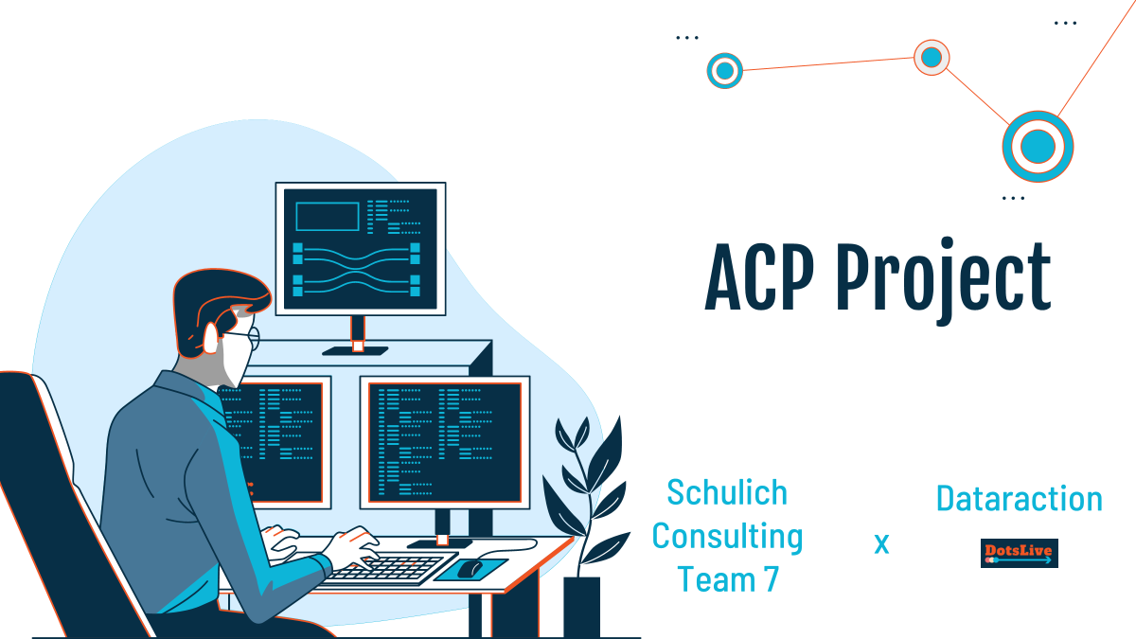
Q&A
Thank you for listening to our presentation. And thank you for this learning opportunity.

